Slide 1

The Damai: A Seamless Hotel Booking Experience
The Damai is a user-friendly website that simplifies the hotel booking process. The website offers a wide range of hotels across different destinations and provides a smooth, intuitive experience for users.

Slide 2

About The Damai: Our Mission and Vision
1
Mission
2
Vision
To simplify hotel bookings, empowering travelers to find their perfect accommodation with ease.
To become the leading platform for hotel bookings, connecting travelers with a diverse selection of hotels.

Slide 3
Front-end Technologies: HTML, CSS, and JavaScript
HTML
CSS
JavaScript
Provides the website structure, defining elements like headings, paragraphs, and forms.
Styles the website, enhancing its visual appeal and ensuring a consistent user experience.
Adds interactivity, handling user interactions, dynamic updates, and animations for a smooth user experience.

Slide 4




Back-end Technologies: Apache, JDBC, and MySQL
Apache
JDBC
MySQL
The web server manages incoming requests and sends responses, ensuring efficient website operation.
Connects the website to the database, enabling data access and manipulation for booking, payment, and user management.
The database stores all website data, including hotel information, user details, and booking records, ensuring data integrity and security.

Slide 5

Features and Functionalities of The Damai
Hotel Search
Users can easily search for hotels based on location, dates, budget, and preferences, like star ratings and amenities.
User Account
Users can create accounts to manage bookings, update preferences, and access previous bookings.
Booking Process
Users can book their preferred rooms directly through the website, with secure payment processing and confirmation emails.

Slide 6
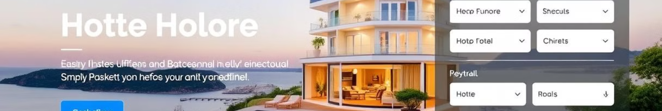
User-friendly Interface and Intuitive Navigation
Visual Appeal
1
The website's design is clean and modern, ensuring a pleasant user experience and easy navigation.
2
Navigation
A clear and consistent navigation menu helps users easily navigate between sections and find the information they need.
User Experience
3
Intuitive design elements and clear instructions make the booking process simple and straightforward for all users.

Slide 7
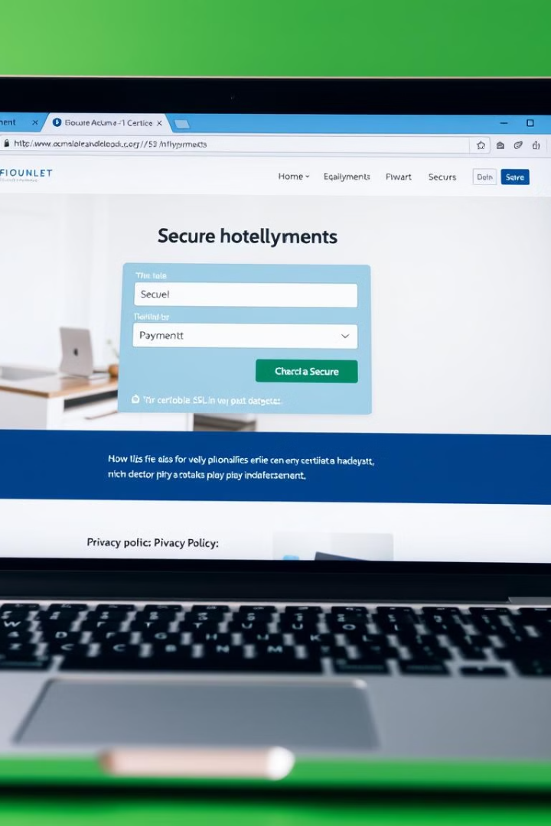
Secure Booking and Payment Processes
Secure Payment Gateway
Integrated with trusted third-party payment providers to ensure secure payment processing.
Data Encryption
All sensitive data, including credit card information, is encrypted during transmission and storage.
Verification and Authentication
Multiple security layers and authentication measures are employed to prevent unauthorized access and fraud.

Slide 8
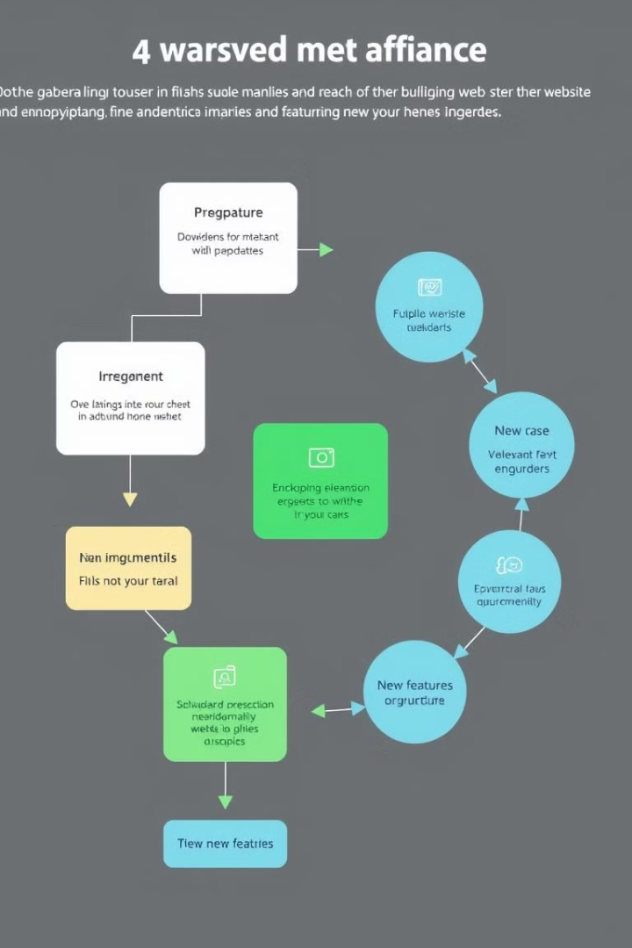




Future Enhancements and Roadmap
Personalized Recommendations
Mobile App Development
Creating a mobile app for users to access the website and book hotels on their smartphones.
Developing a recommendation system that suggests hotels based on user preferences and past bookings.
Live Chat Support
Expand Hotel Inventory
Implementing a live chat feature to provide immediate assistance and answer user questions.
Partnering with more hotels and expanding the website's inventory to offer a wider range of choices.

